Slide 1

Summary of Papers: A presentation
Link to spreadsheet
By Shrey Gupta

Slide 2
Introduction
A study by WHO indicates that 42% of children below the age of 6 and 40% of pregnant women worldwide are anemic.
Iron deficiency anemia is estimated to be present in 1.6 billion people globally and more than 85% of the populations in Africa and Asia.
Anemia has a slow evolution, since the human body implements compensatory mechanisms, and when the compensation can no longer guarantee an adequate dose of oxygen, symptoms such as fatigue, paleness, and many others appear.
Cons of clinical assessment of anemia
The gold standard CBC Hgb level measurement requires:
blood sampling by a trained phlebotomist,
a clinical hematology analyzer with the required electrical power,
biochemical reagents, and
infrastructure thereof, along with a trained laboratory technician to perform the analysis,
all of which are especially problematic in rural and low-resource settings, where anemia is most prevalent

Slide 3
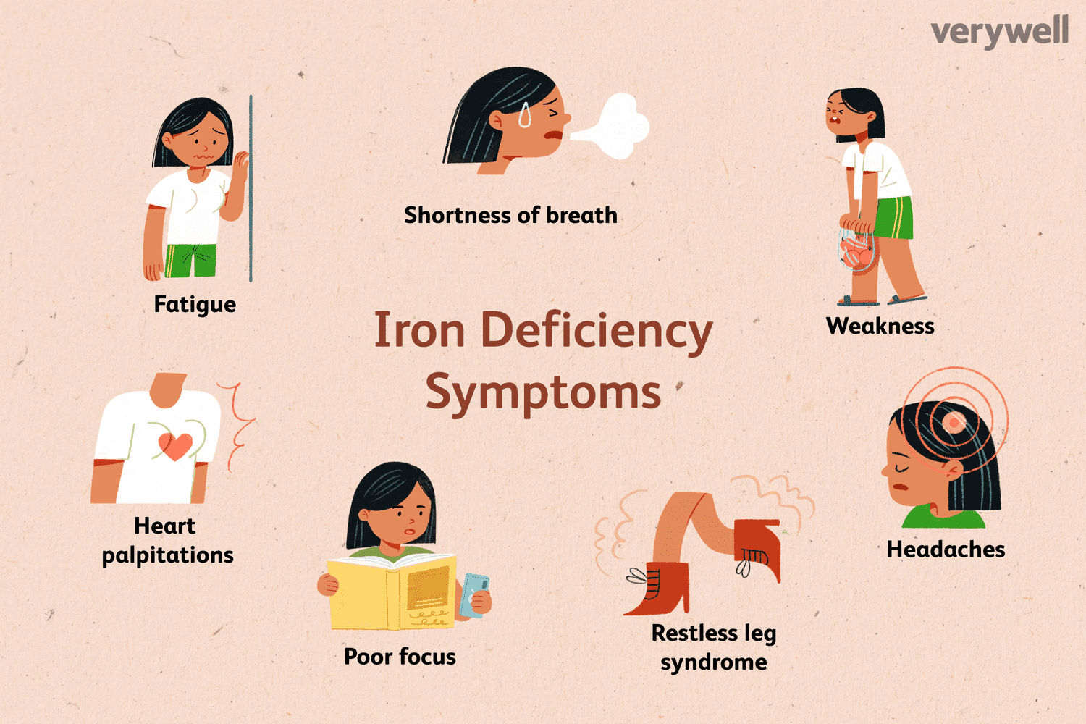
Anemia Overview
Occurs when the body lacks sufficient hemoglobin leading to reduced oxygen-carrying capacity
Iron-Deficiency Anemia is the most common type caused by insufficient iron intake or absorption, leading to decreased hemoglobin production
Some of the common symptoms of are
Fatigue and weakness
Pale skin and nail beds
Shortness of breath
Headache
Irregular heartbeat

Slide 4
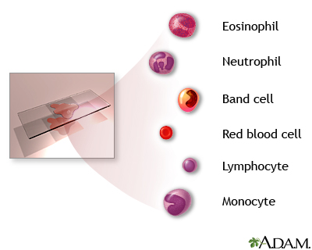
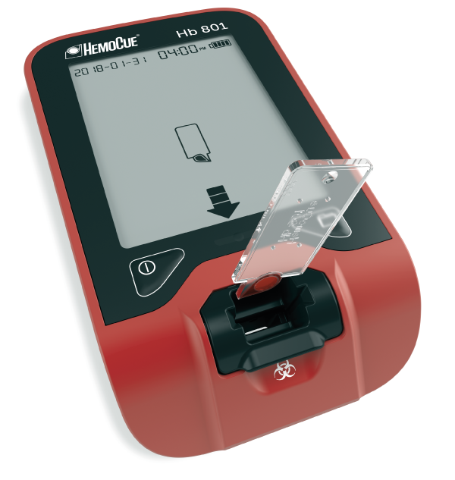
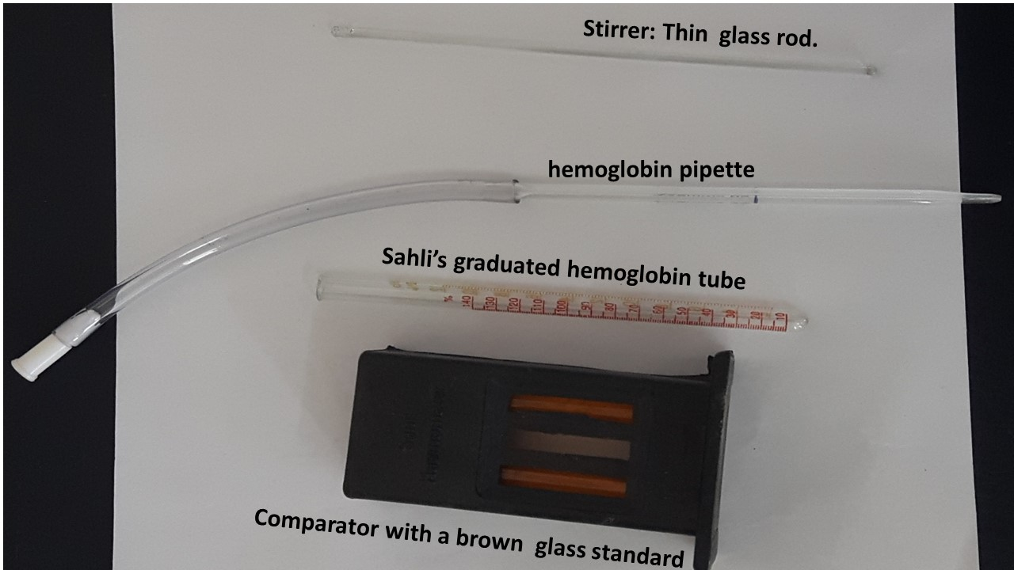
Traditional Anemia Detection Methods
Limitations and Challenges
The Complete Blood Count (CBC) is the gold standard test of anemia.
Hemocue
Sahli’s Method For The Estimation Of Hemoglobin
These test needs trained technicians with specialized laboratory equipment that may not be available in rural areas.
Also, clinical testing is time-consuming, costly, and painful.
It becomes inconvenient if someone suffers from chronic anaemia and needs to visit the hospital frequently for regular diagnosis and monitoring.
Notes:
Sahil’s Method
When the blood is added to dilute hydrochloric acid (HCl), hemoglobin present in the RBCs is converted into brown-colored acid hematin. The acid hematin solution is further diluted until it’s color matches exactly with the permanent standard brown glass compared by direct vision

Slide 5
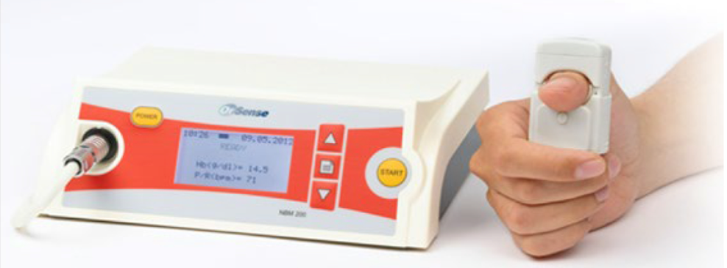
Non-Invasive Anemia Detection
Different Techniques Explored
Noninvasive procedures do not involve tools that break the skin or physically enter the body.
Therefore
It avoids discomfort associated with blood sampling,
Eliminates biohazardous specimen handling, and
Enables real-time Hb level monitoring
Spectrophotometry or photoplethysmography (PPG) to identify the spectral pattern of Hb in underlying blood vessels to determine Hb level
Clinicians diagnose anemia at the primary care level by examining palmar, nailbed, and conjunctiva for pallor
Thus there is great interest in developing methods that analyzes pallor of palm, nailbed, fingertip or conjunctiva using the power of AI for the diagnosis of anemia
Among the methods the most common methods I have come across use SVM, k-NN, regression, ANN, CNN etc
NBM-200
Notes:
The working principle of both methods is based on the Beer-Lambert law, I0 = Ie−α·C·D, where I0 is output light intensity, I is incident light intensity, α is the light absorption coefficient, C is the concentration of Hb, and D is the light path.

Slide 6
Research Paper [1]
Aim
To demonstrate a system in which accurate Hgb measurements are obtained with a smartphone without the need for any external equipment
Why fingernail?
Fingernails are straightforward for a user to self-image, unlike conjunctiva, and also have low person-to-person size and shape variability, unlike palmar creases
Methodology
Fingernail data, skin color data, and image metadata were extracted from fingernail bed smartphone images via MATLAB (Mathworks, Natick, MA)
Regions of interest, were manually selected Color data were extracted from each region and averaged together across fingers for each subject
An algorithm was then written in MATLAB utilizing robust multi-linear regression with a bisquare weighting algorithm to relate the image parameter data to CBC Hgb levels for each patient
Training
To develop the algorithm as a tool to screen for anemia, the entire study population was randomly split into a discovery group and a testing group
This process was repeated 1000 times with different, discovery/testing groups to minimize residual error, thereby optimizing the parameters of the algorithm

Slide 7
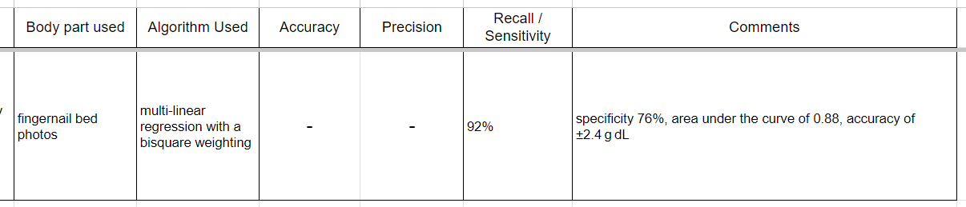

Slide 8
Research Paper [2]
Aim
To develop a device that is not expensive and simple to use for assessing the anemic condition
Why Conjunctiva?
Many studies show great interest in the pallor of body parts to estimate Anemia such as palmar pallor, image processing of a fingertip video, conjunctival pallor, etc.
One of the studies compared the analysis of palmar and conjunctival pallor to detect Anemia: they found that there was a greater level of sensitivity to conjunctival pallor than to palmar pallor
Also, for many years, physicians in common practice have estimated Anemia in people by observing the eyelid conjunctiva.
Preprocessing
The palpebral conjunctiva of the acquired samples were manually segmented by a haematologist
Feature Selection
After many experiments, the best classification result were obtained by considering 3 features in total, namely, a*, b* and the G value extracted from the RGB component images.

Slide 9
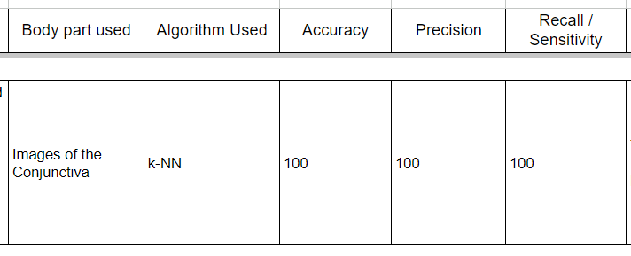
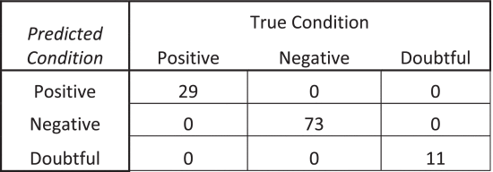
Performance Metrics
Confusion Matrix

Slide 10
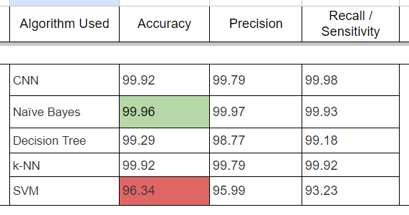
Research Paper [3]
Aim
Using the pallor of the palm to detect anemia using machine learning algorithms through a comparative study of Decision Tree, SVM, Naïve Bayes, k-NN and CNN
Conclusion
All of the proposed models used in the study produced or achieved significant results
Naïve Bayes attained 99.96% accuracy which is the highest among all the models
k-NN and the CNN both had an accuracy of 99.92% each

Slide 11
Preprocessing
After collecting the images, the triangle thresholding approach was used to extract the features of the palm images to generate the ROI
Then image augmentation technique was done on the original datasets, which includes rotation, flipping, and translation, to expand the size of the original datasets
Next, the extracted Region of Interest (ROI) is divided into metrics through the utilization of the CIE L*a*b* colour space intensity value of the pictures (The L*a*b colour space is intended to simulate human eyesight or perception).
There is a strong relationship between a* components and Hb levels when calculated using the Pearson Correlation Index
Feature Selection
The best classifying result was reached after numerous trials by integrating three-component features in total, namely a*, b*, and the G value derived from the RGB component photos
The L and RGB component values were retained for filtering the incoming data.
The mean values of the characteristics a*, b*, and G were carefully calculated by considering just the image pixels with minL < L < maxL and min < R = G = B < max.
This last filtering guarantees that image pixels that are abnormally dark or bright are deleted

Slide 12
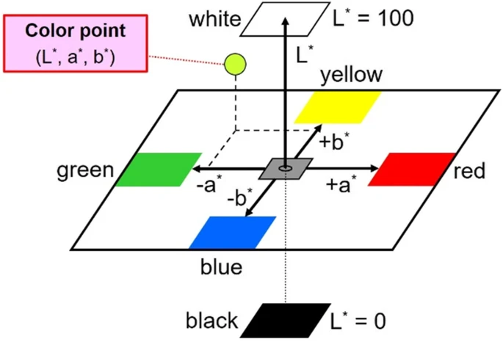
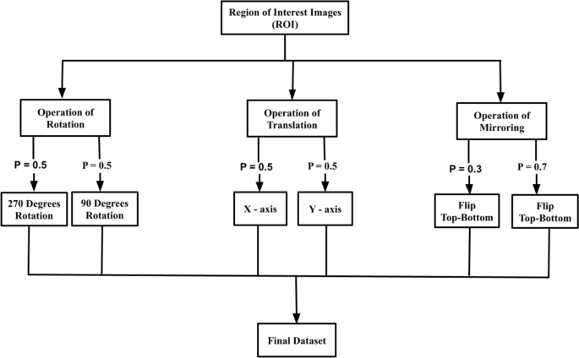
CIELab color space
Data Augmentation

Slide 13
Research Paper [4]
Aim
Compare Naïve Bayes, CNN, SVM, k-NN, and decision tree algorithms to detect anemia
Compare the conjunctiva of the eyes, the palpable palm, and the color of the fingernail images to justify which of them has a higher accuracy for detecting anemia in children
Used the largest publicly available dataset of 710 images for each class
Same preprocessing as the previous paper
In the process of augmenting the images, the original datasets for each image, were rotated 90°, and 270°, flipped and utilized a translation to the X and Y axis.
Afterwards a 70:10:20 split was done to the dataset
Conclusion
The CNN achieved a higher accuracy of 99.12%, while the SVM had the least accuracy of 95.4%

Slide 14
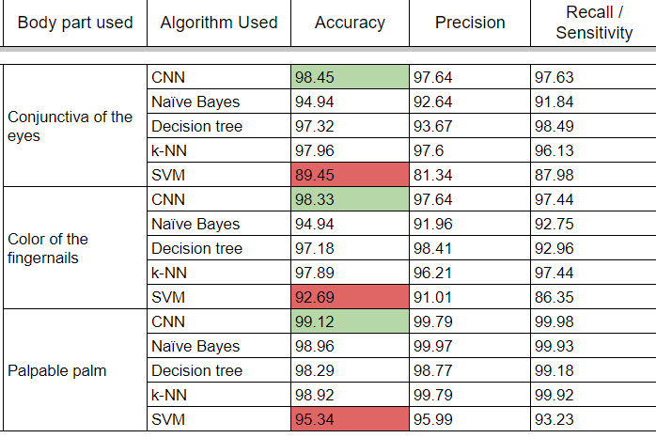

Slide 15
Conclusion
Here is the summary of the performance metrics of all the papers I have read so far Link to spreadsheet
Non-Invasive Anemia Detection avoids discomfort associated with blood sampling, and enables real-time Hb level monitoring
Manual segmentation is more reliable but more time consuming and effort based work, thus automated segmentation or preprocessing should be done to save time and resources
Conjunctiva, Fingernail bed, fingertip and Palmar pallor, all can be utilised for anemia detection But whether to use a combination of such pallor or a single one should be decided after trying out all the combinations
All the algorithms mentioned such as k-NN, CNN, SVM, Linear Regression are all viable method for detecting anemia
Final type of algorithm can be decided only by testing with actual data

Slide 16


